Slide 1
Lecture 3b: Introduction to Finite State Machines (FSM)
To watch lecture video click link below
Lecture 3b video
To view slides, continue to next slide

Slide 2
Lecture 3b: Introduction to Finite State Machines (FSM)
An FSM for a Turnstile.
Figure credit: Wikipedia.org

Slide 3
Finite State Machines (FSM)
Graphical depiction to describe the behavior of flip-flops and sequential circuits
Moore machine
JK flip-flops
Associates output with states
Mealy machine
Associates an output with each transition

Slide 4
Finite State Machine – Overview
An FSM illustrates state transitions
Transition from current state to next state with given input
A simple example
Input could be multiple bits, e.g. 00, 01, …
Output may also be associated
Moore machines and Mealy machines represent output differently
Current state | Input | Next state
A | 0 | B
A | 1 | A
B | 0 | B
B | 1 | B

Slide 5
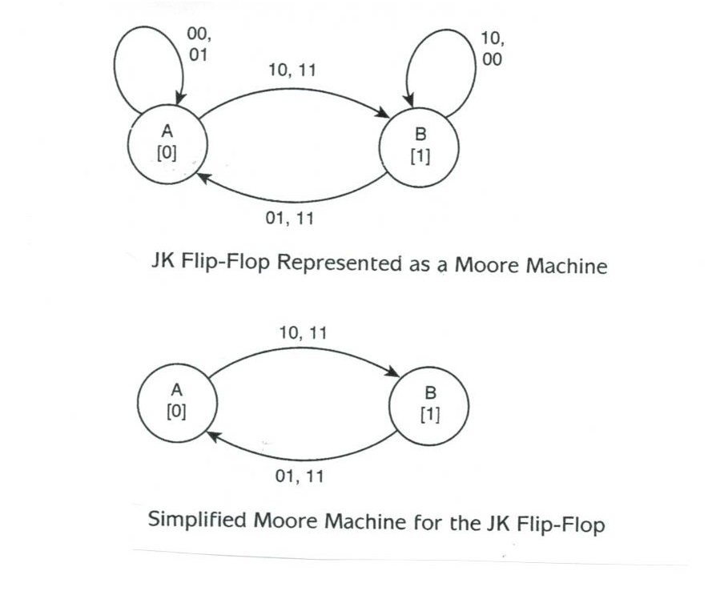
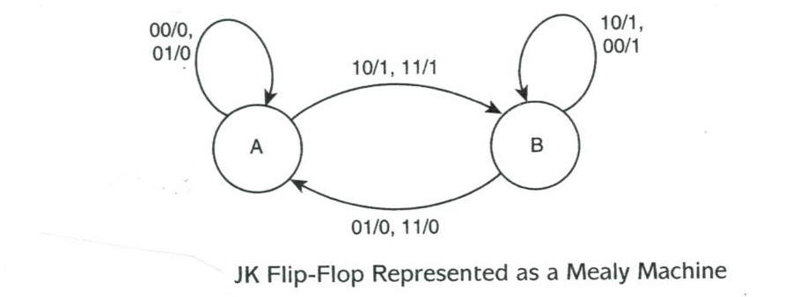
Moore Machine vs. Mealy Machine
Moore machine: output associates with state, e.g. tate A associates with output 0, i.e. A[0].
Mealy machine: output associates with transition, e.g. transition from A to B, with input 10 or 11 the output is 1, i.e. 10/1 or 11/1 from A to B.

Slide 6
How to create a Moore FSM
Step 1: make state-output association, i.e. we designate state A corresponding to output 0, state B to output 1
Current State | Input (JK) | Next state | Output
A | 00 | A | 0
A | 01 | A | 0
A | 10 | B | 1
A | 11 | B | 1
B | 00 | B | 1
B | 01 | A | 0
B | 10 | B | 1
B | 11 | A | 0
A
[0]
B
[1]
Step 2: make transitions for each row of truth table. Below shows transition for the first row (state A with input to state A) and the third row (state A with input 10 to state B)
00
A
[0]
10
B
[1]

Slide 7
Moore machine for JK Flip-Flop
You may combine transition for multiple inputs, i.e. A -> B input 10 could be combined with A ->B input 11 as A -> B input 10,11.
Once you finish all rows of the truth table, a Moore machine is created as shown here.

Slide 8
How to create a Mealy FSM
Step 1: designate states, i.e. A and B
A
B
Current State | Input (JK) | Next state | Output
A | 00 | A | 0
A | 01 | A | 0
A | 10 | B | 1
A | 11 | B | 1
B | 00 | B | 1
B | 01 | A | 0
B | 10 | B | 1
B | 11 | A | 0
Step 2: for each row of the truth table, make the transition, e.g. for the third row, state A with input 10 goes to state B with output 1, i.e. A -> B with 10/1.
A
10/1
B

Slide 9
Mealy Machine for JK Flip-Flop
Similarly you may combine transitions
Once you finish all rows of the truth table, a Mealy machine is created as shown here.

Slide 10
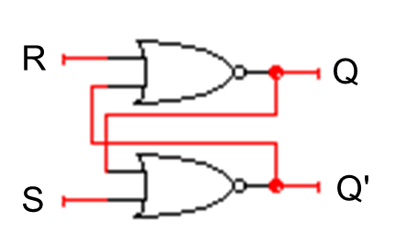
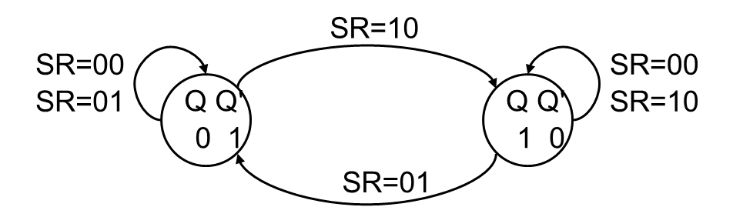
Quick Practice: SR flip-flop
Question: Is this Moore or Mealy machine?

Slide 11
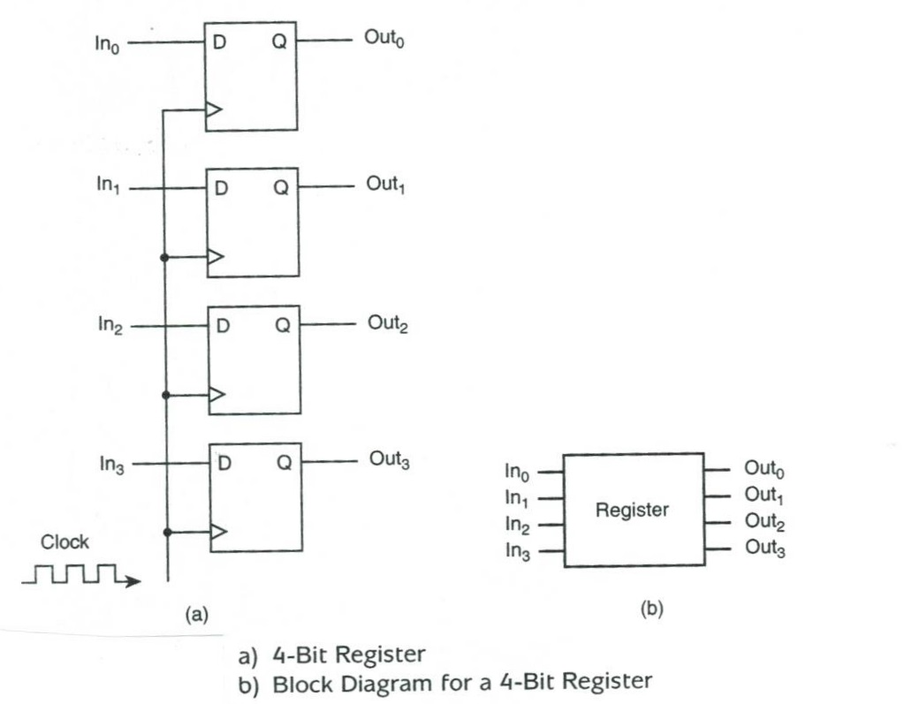
Examples of Sequential Circuits: 4-bit register

Slide 12
Summary
Description of flip-flops using finite state machines
Compare and contrast Moore machine and Mealy machine
To Do:
zyBook 8.10

